Slide 1


Bitcoin Futures AUTOMATED Trading Bot
Binance USDT-M Futures • Opening Range Breakout • ML Take-Profit

Slide 2

Intro & Problem
Automated Trading Bot for Asian Session
this project is an automated Bitcoin futures trading bot for the Asian session. It trades BTCUSDT on Binance USDT-margined futures using an opening range breakout strategy.
The main idea is to remove emotional, manual trading and let a bot detect breakouts, size positions based on risk, and manage take-profit and stop-loss automatically, while I just supervise everything from a web dashboard.

Slide 3


Problem & Idea
The Need for Automation
Problem: manual BTC trading is emotional, slow, and hard to monitor.
Goal: fully automated BTCUSDT futures bot for the Asia session (00:00–04:00 UTC ORB).
Core idea: Opening Range Breakout + ML-predicted take-profit.
Monitoring: simple web dashboard showing account, positions, and live logs.

Slide 4

Strategy & Model
Opening Range Breakout with ML Target
The strategy is an opening range breakout. Between 00:00 and 04:00 UTC, the bot builds an opening range high and low for BTCUSDT futures. After 04:00, if price breaks above the range high, the bot looks for a long trade.
To choose a more intelligent targets, I trained a Random Forest regression model on historical ORB trades. It predicts a risk–reward multiple, and the bot converts that into a take-profit price for each trade.

Slide 5

Strategy & ML Model Details
Technical Implementation
1
Opening Range: build high (RH) and low (RL) from 00:00–04:00 UTC.
2
Signal: go long when a 1‑minute candle closes above RH.
3
Features to model: orb_range, candle_range, momentum, ATR(20), range_ratio, time-of-day.
4
Model: Random Forest regressor predicts R:R for each setup.
5
TP: entry + predicted_RR × (entry − RL); SL stays at RL.

Slide 6
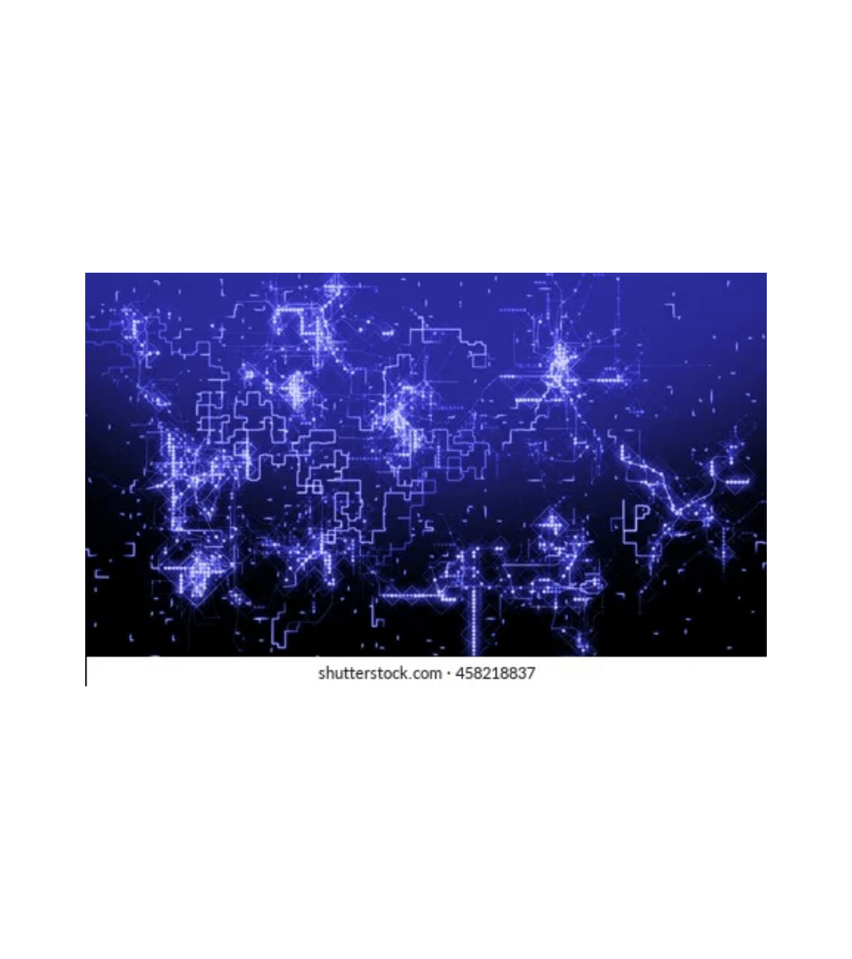
Architecture & Dashboard
System Components
The system has three main pieces. First, a Python futures trading bot that connects to the Binance USDT-margined Futures API, fetches 1-minute data, detects the ORB breakout, and executes long trades with leverage.
1
Python Trading Bot
Connects to Binance API, fetches data, detects breakouts, executes trades with leverage
2
Risk Engine
Sizes each position to risk ~1% of account, respects Binance minimum notional
3
Flask Dashboard
Shows account info, open positions, and live bot logs in a simple web page

Slide 7






Architecture Details
Infrastructure and data flow for the automated trading system.
Data
Binance Futures 1‑minute BTCUSDT candles (USDT‑M testnet).
Bot core
Python + Binance Futures API + Random Forest model.
Risk & orders
Position sizing by % equity, market entry, SL + TP orders.
Infrastructure
Runs on an Ubuntu server with a virtual environment.
Dashboard
Flask web app – shows price, balance, margin, leverage, positions, and last logs.

Slide 8

Risk & Results
Management and Performance
Risk management is built into the bot. Each trade is sized to risk around one percent of equity, with diagnostics to ensure the position is not too small or too aggressive. The bot uses stop‑loss and take‑profit market orders, and it only opens one new trade per day, but trades can stay open for longer, so risk is stacked carefully across days.
In backtests on historical BTC data, the ORB strategy with the ML take‑profit performed better than fixed profit targets, and the live bot on futures testnet shows that the logic can run end‑to‑end without manual intervention.

Slide 9







Risk & Wrap‑Up
Summary of the bot's risk management, trading focus, and future roadmap.
Risk per trade
~1% of account using leveraged position sizing.
Always trades
BTCUSDT long on Binance USDT‑M futures (Asia session focus).
ML improves
Take‑profit placement over fixed R:R targets.
Dashboard makes
The bot observable and safer to monitor.
Future work
Add short side, more features, and live deployment on mainnet with strict limits.

Slide 10
Thank You
Bitcoin Futures ORB AUTOMATED Trading Bot
Binance USDT-M Futures • Opening Range Breakout • ML Take-Profit

